Slide 1


Analyzing the Effects of Fintech on the Banking Industry with Foursquare Developers API
Ian Alexei Zelaya

Slide 2
Introduction
The fintech industry has revolutionized how the banking industry interacts with its customers.
PayPal company
Singapore and China

Slide 3
Objective
In general, understand how fintech has affected the banking industry. 3 specific objectives:
Divergence between countries with high and low fintech innovation
Divergence between big and small cities
Divergence between neighborhoods of high and low income

Slide 4
Data Section
Foursquare API
Openmapstreet API
Statistical Atlas

Slide 5
Methodology
Part I:
The Institute for Financial Services Zug (IFZ) of the Lucerne University of Applied Sciences
Singapore, Zurich, Amsterdam, Buenos Aires, Mumbai and Sao Paulo
GeoJSON Polygons
Random_Point_Generator

Slide 6
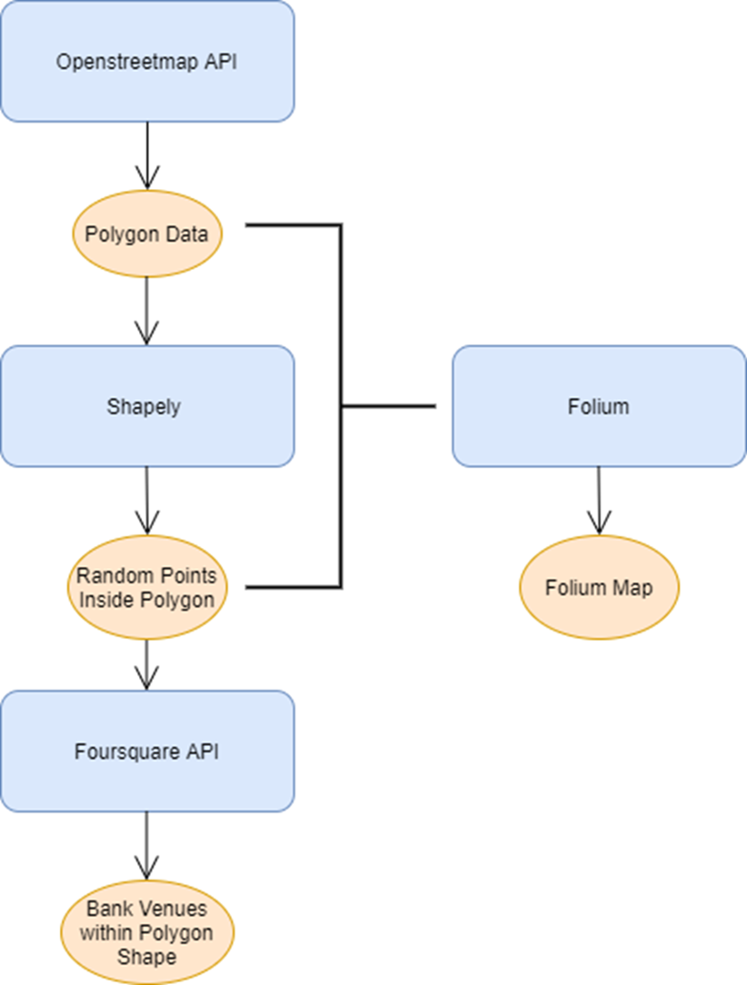

Slide 7
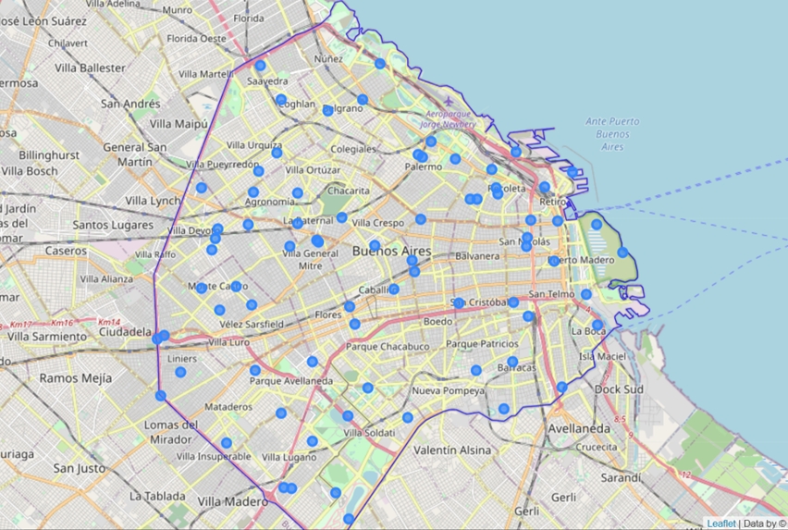

Slide 8
Methodology (continuation)
Part II:
United States
BeautifulSoup
Venue_Extractor

Slide 9
Methodology (continuation)
Part III:
Federal Reserve Bank of New York
New York, Washington, Chicago, Houston, and Los Angeles
Web Scraping – Statistical Atlas

Slide 10
Results

Slide 12
Discussion
Time series for a city
Foursquare API limited free requests
Openstreetmap frequently returns none

Slide 13
Conclusion
The results for hypothesis I suggest that fintech innovation may influence the number of bank establishments in a city, but other factors such as overpopulation will also have an influence on the number of banks per capita.
The results for hypothesis II suggest that the size of a city affects the number of bank establishments per capita. The bigger the city, the lower the number of banks. However, this result may be due to overpopulation and not because of fintech innovation.
The results for hypothesis III suggest that the level of income of a neighborhood causes a change in the number of bank establishments per capita. The higher the income in a neighborhood, the greater number of banks establishments. However, this result may be due to a closer distance of high-income neighborhood to the business sector of a city in comparison with low-income neighborhood.

